Slide 1
Lizards of South America: A Survey of Biodiversity and Ecological Significance

Slide 2
Lizards of South America: An Ecological and Biological Perspective
South America is home to a diverse range of lizard species, each with its unique characteristics and adaptations to the various habitats found across the continent. This comprehensive research delves into the fascinating world of South American lizards, exploring the diverse families that call this continent home.

Slide 3
Lizards of South America: An Introduction
South America is home to an impressive diversity of lizard species, belonging to various families and exhibiting a remarkable range of colors, patterns, and behaviors.

Slide 4
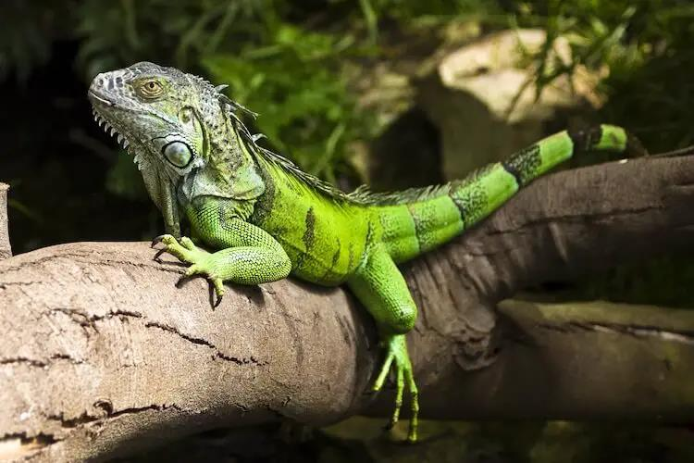

Slide 5
The Tepui Lizard (Pristidactylus urichi) is a captivating and unique reptile inhabiting the Tepui plateaus of South America.
The Caiman Lizard and the Tepui Lizard are two captivating reptile species found in South America. Both possess unique adaptations that allow them to thrive in their respective environments. However, they face threats such as habitat destruction and illegal trade, emphasizing the need for conservation efforts.

Slide 6
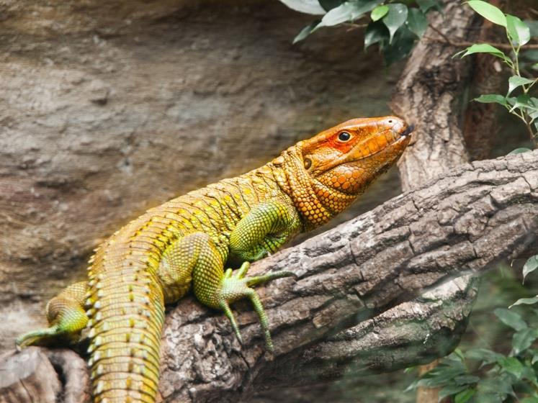

Slide 7
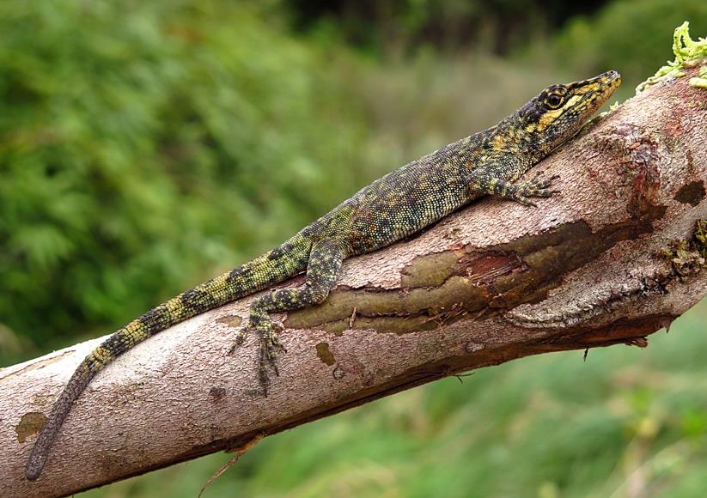

Slide 8
South American Lizards: Ecology, Threats, and Conservation
South America is home to an incredible diversity of lizards, including the Green Iguana, Caiman Lizard, and Tepui Lizard. These captivating creatures occupy a variety of habitats, from tropical forests to aquatic environments, and play crucial ecological roles in their respective ecosystems. However, they face various threats, including habitat loss, illegal pet trade, and climate change, which highlight the need for conservation efforts to ensure their longterm survival.

Slide 9
The text discusses the importance of conserving South American lizards and the threats they face. It argues that responsible research, education, and community involvement can help protect their habitats and promote their welfare. It also highlights the need for conservation initiatives and protected areas to ensure their preservation. The text concludes by emphasizing the value these lizards bring to the continent's natural heritage and ecological stability and the importance of appreciating and conserving them to preserve their diversity and uphold the integrity of delicate ecosystems.
South American lizards are threatened by habitat loss, climate change, and illegal trade, requiring responsible research, education, and community involvement to conserve their habitats and promote their welfare.

